Slide 1
KUKA KRC4
Operators

Slide 2
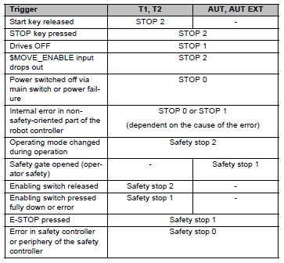
Safety
Triggers for stop reactions

Slide 3
Safety
Overview of the safety functions
Selecting the operating mode
Operator safety (= connection for the monitoring of physical safeguards)
EMERGENCY STOP device (must pressed at least once every 12 months)
Enabling device
External safe operational stop
External safety stop 1
External safety stop 2
Velocity monitoring in T1

Slide 4

Safety
Selecting the operating mode
The industrial robot can be operated in the following modes:
Manual Reduced Velocity (T1)
Manual High Velocity (T2)
Automatic (AUT)
Automatic External (AUT EXT)

Slide 5
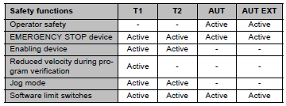
Safety
Overview of operating modes and safety functions
The following table indicates the operating modes in which the safety functions are active.

Slide 6
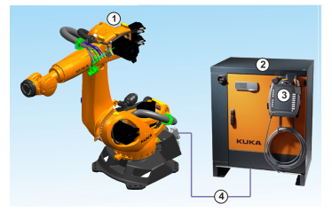

Robot System
Overview of the industrial robot
The industrial robot consists of the following components:
Manipulator
Robot controller
Teach pendant
Connecting cables
Software
Options, accessories

Slide 7
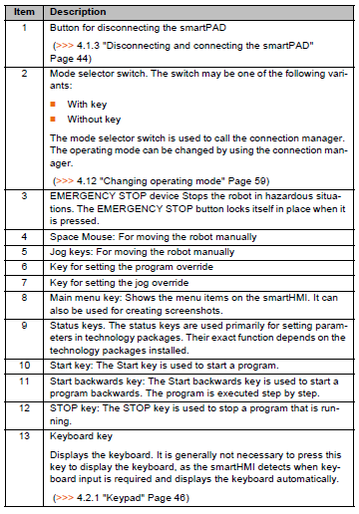
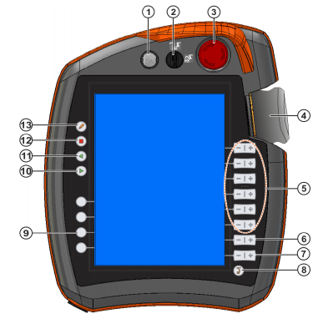
Operating
SmartPAD

Slide 8
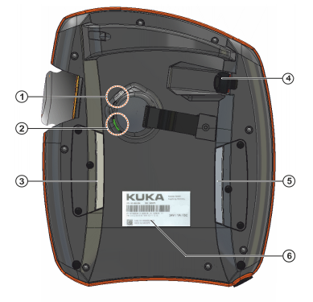
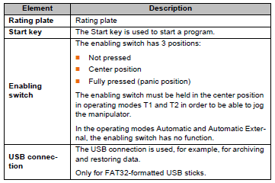
Operating
SmartPAD Rear view
1 Enabling switch
2 Start key (green)
3 Enabling switch
4 USB connection
5 Enabling switch
6 Identification plate

Slide 9
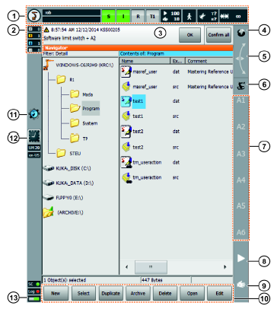
Operating
KUKA smartHMI user interface
1 Status bar
2 Message counter
3 Message window
4 Space Mouse status
5 Spave Mouse alignment
6 Jog keys status
7 Jog key labels
8 Program override
9 Jog override
10 Button bar
11 WorkVisual icon
12 Clock
13 Life sign display

Slide 10

Operating
Status Bar
1 Main menu key
2 Robot name
3 If a program has been selected, the name
4 Submit interpreter status indicator
5 Drives status indicator
6 Robot interpreter status indicator
7 Current operating mode
8 POV/HOV status indicator
9 Program run mode status indicator
10 Tool/base status indicator
11 Incremental jogging status indicator

Slide 11
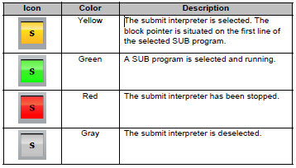
Operating
Submit interpreter status indicator

Slide 12
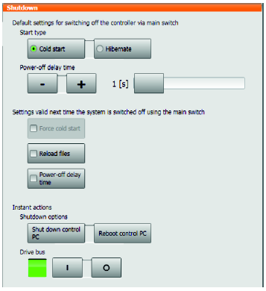
Operating
Exiting or restarting KSS
The KSS starts in whatever operating mode was most recently selected. Exceptions:
If the most recent operating mode was T2, the mode after starting is T1.
After an initial cold start, the operating mode is T1.
Procedure
1. Select the menu item Shutdown in the main menu.
2. Select the desired options.
3. Press Shut down control PC or Reboot control PC.
4. Confirm the request for confirmation with Yes. The System Software is terminated and restarted in accordance with the selected option.
After the restart, the following message is displayed:
Cold start of controller
Or, if Reload files has been selected: Initial cold start of controller

Slide 13
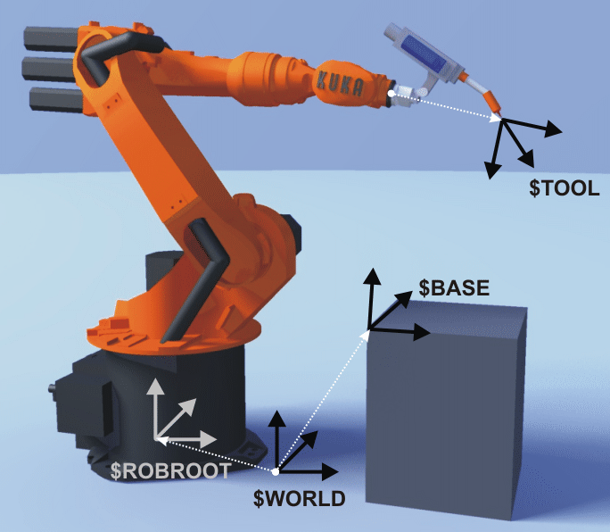
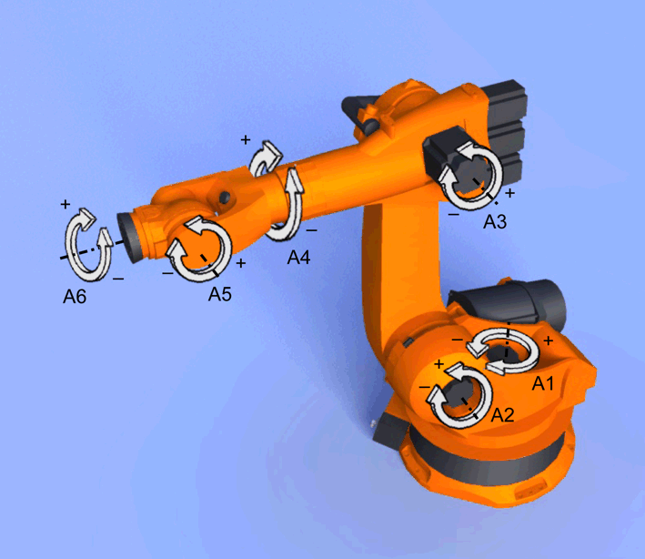
Operating
Jogging
There are 2 ways of jogging the robot:
Cartesian jogging; The TCP is jogged in the positive or negative direction along the axes of a coordinate system.
Axis-specific jogging; Each axis can be moved individually in the positive or negative direction.

Slide 14
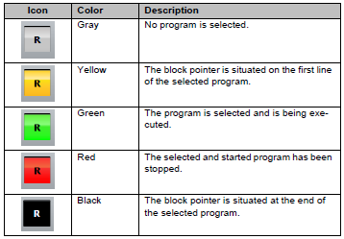
Operating
Starting Automatic External mode
Robot interpreter status indicator
Procedure;
1. Select the program CELL.SRC in the Navigator. (This program is located in the folder “R1”.)
2. Set program override to 100%. (This is the recommended setting. A different value can be set if required.)
3. Carry out a BCO run:
Hold down the enabling switch. Then press the Start key and hold it down until the message “Programmed path reached (BCO)” is displayed in the message window.
4. Select “Automatic External” mode.
5. Start the program from a higher-level controller (PLC).
To stop a program that has been started in Automatic mode, press the STOP key.

Slide 15
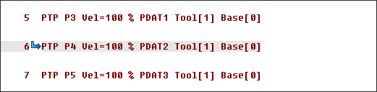


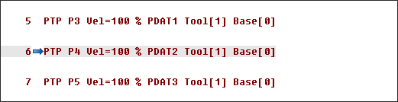

Operating (advanced)
Block pointer
The robot moving from P3 to P4
The robot has reached P4 with exact positioning
Program run modes
Designation | Status Indicator | Descriptions
Go #GO |  | The program is executed through to the end without stopping.
Motion #MSTEP |  | The program is executed with a stop at each point, including auxiliary points and the points of a spline segment. The Start key must be pressed again for each point. The program is executed without advance processing.
Single Step #ISTEP |  | The program is executed with a stop after each program line.

Slide 16


Operating (advanced)
Starting a program forwards (manual)
Precondition
A program is selected.
Operating mode T1 or T2
Procedure
1. Select the program run mode.
2. Hold the enabling switch down and wait until the status bar indicates
“Drives ready”:
3. Carry out a BCO run: Press Start key and hold it down until the message
“Programmed path reached (BCO)” is displayed in the message window. The
robot stops.
4. Press Start key and hold it down.
The program is executed with or without stops, depending on the program run mode.
To stop a program that has been started manually, release the Start key.

Slide 17
Operating (advanced)
Carrying out a block selection
Description
A program can be started at any point by means of a block selection.
Precondition
A program is selected.
Operating mode T1 or T2
Procedure
1. Select the program run mode.
2. Select the motion block at which the program is to be started.
3. Press Block selection. The block pointer indicates the motion block.
4. Hold the enabling switch down and wait until the status bar indicates
“Drives ready”:
5. Carry out a BCO run: Press the Start key and hold it down until the message
“Programmed path reached (BCO)” is displayed in the message window.
The robot stops.
6. The program can now be started manually or automatically. It is not necessary to carry out a BCO run again.

Slide 18

Operating (advanced)
Resetting a program
Description
In order to restart an interrupted program from the beginning, it must be reset.
This returns the program to the initial state.
Precondition
Program is selected.
Procedure
Select the menu sequence Edit > Reset program.
Alternative procedure
In the status bar, touch the Robot interpreter status indicator. A window opens. Select Reset program.

